Slide 1

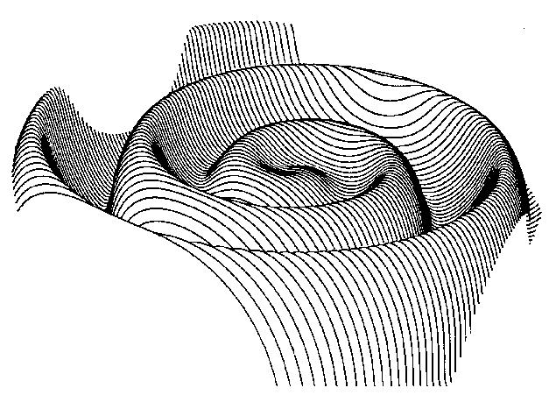
ACE AND JUNO OBSERVATIONS OF RADIAL MAGETIC FIELD
Nelson Talukder
Supervisor: Robert Forsyth
Picture of the Heliospheric Current Sheet, from:
https://www.nasa.gov/content/goddard/sdo/potw593-magnetic-field-lines-in-time-lapse
l

Slide 2
Aims
To compare R² Br of the IMF at different radial distances from the Sun.
Analyse HCS predictions for directional changes
Discussion of long term decrease in Br
‘After 5 billion years, the Sun is still popping and boiling, unable to settle down into the decadent middle age that simple theoretical considerations would suggest. (...) It appears that the radical element for the continuing thread of cosmic unrest is the magnetic ﬁeld. ‘
- E.N. Parker, Cosmical Magnetic Fields, 1979 ^{[1]}
[1] Solanki S. K., Inhester B. & Schussler M. The solar magnetic ﬁeld. Rep. Prog. Phys. 69 563–668, 2006.

Slide 3
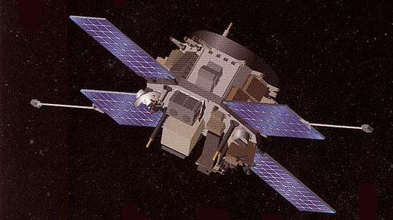
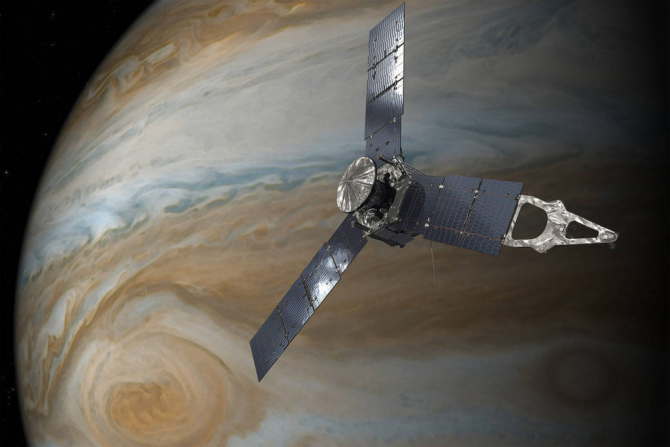
Juno
Launched on the 5th August 2011 by NASA.
Took IMF measurements between Earth and Jupiter.
Began a Polar Orbit of Jupiter in July 2016.
ACE
Located at the Lagrangian point L1.
Measures the IMF and the solar wind upstream of Earth.
Pictures from:
https://www.nasa.gov/mission_pages/juno/images/index.html ,
https://earth.esa.int/web/eoportal/satellite-missions/a/ace

Slide 4
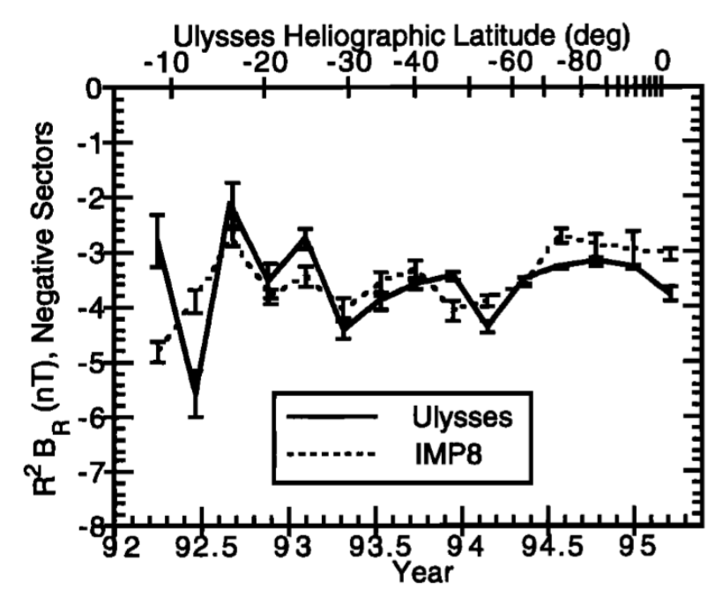
Smith and Balogh, Radial Invariance
Ulysses and IMP-8 data, at solar maximum.
Observed latitudes with fast solar wind.
‘no significant variation in Br attributable to the field of a rotating dipole’ ^{[2]}
Figure 1: Smith and Balogh, radial invariance for a range of latitudes
^{[2]}Smith J. E. & Balogh, A. Ulysses observations of the radial magnetic field. Geophysical Research Letters - GEOPHYS RES LETT. 22. 3317-3320, 1995.

Slide 5
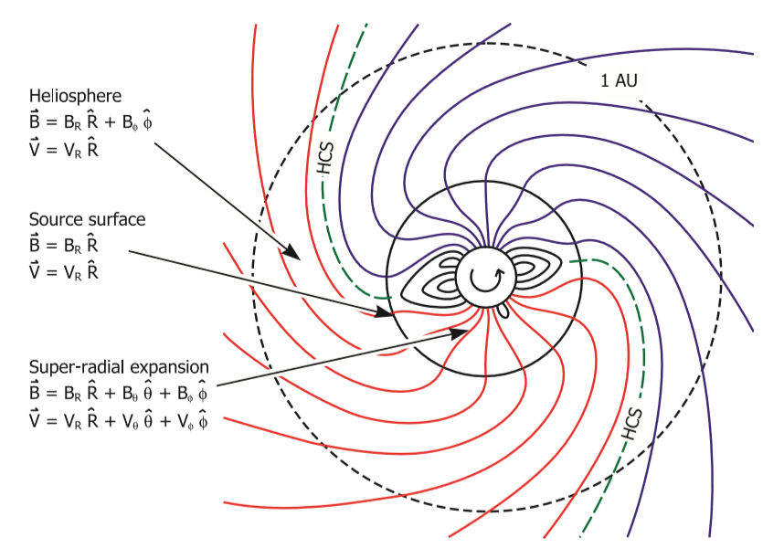
IMF: Frozen-in Theorem
Dynamo theorem ^{[3]} predicts radial field
Field lines within Solar Wind
Solar rotation leads to Archimedean spiral.
Sun tilted at <10 ͦ ^{[4]} to the ecliptic plane.
Figure 2: Parker Spiral, modelling the Sun as a dipole in a non rotating frame ^{[5]}.
^{[3]} Clements D. Suns, Star and Planets lectures notes. Imperial College london, 2017.
^{[4]} Norton A. , Raouafi N.-E. and Petrie G. J. D. The Tilted Solar Dipole. Available from http://iopscience.iop.org/article/10.1086/589684/fulltext/ [accessed 15/03/18].
^{[5]}Forsyth R J., Owens M J. The Heliospheric Magnetic Field. Available from https://link.springer.com/article/10.12942/lrsp-2013-5 [accessed 15/02/18].

Slide 6
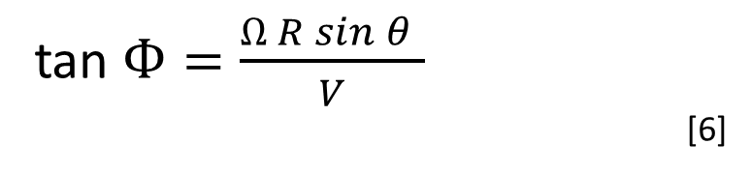
Magnetic Field Direction
Start
Handling
Analysis and graph generation
Dipole comparison for various years
Data, minute averaged
Average over 2 solar rotations
Redefine angles
Hourly averages
Handle Missing data and duplicates
Calculate R^2 Br for each minute
Fluctuation removal
Daily averages
Separate Negative and positive sectors
Averaging
Compare magnetic activity to sunspot number
tan $Ф=\frac{Ω R sin⁡θ }{V}$
[6]
45 ͦ at the Earth, 58 ͦ to 66 ͦ for Juno, ±1.3 ͦ. R
Several high frequency fluctuation in data
Potential repetitive structure over a solar rotation ^{[7]}.
Longer averaging is more consistent.
Figure 3: Flow map of the modules within the programme.
*Fluctuations explained in further detail.
^{[6]} Forsyth R J., Owens M J. The Heliospheric Magnetic Field. Available from https://link.springer.com/article/10.12942/lrsp-2013-5 [accessed 15/02/18]. ^{[7]} Eastwood J. Space Physics Lecture Notes, Chapter 3. Imperial College london, 2018.

Slide 7
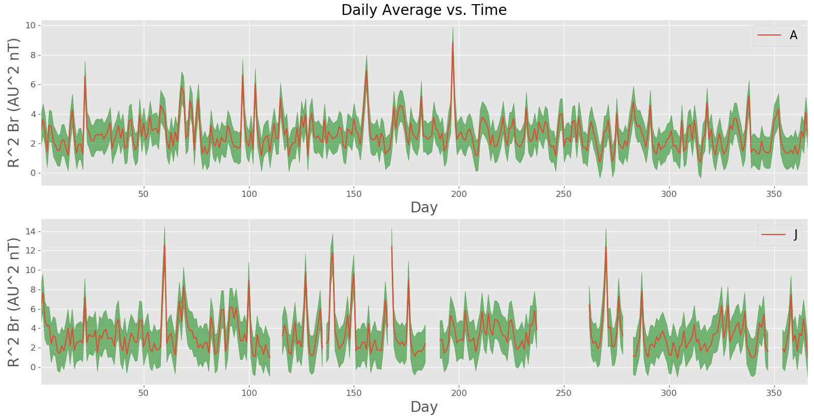
Field Strength, |R²Br|
Figure 4: Daily Averages

Slide 8
Reduce Fluctuations*
START
Read in current value from sequence
Check if the previous value was same sign as current
NaN values placed in separate sequence
Yes
No
Figure 5: Programme module for fluctuation reduction
Add, previous sequence
Check if previous sequence was < 6 hours
Yes
No
Check if < 24 Fluctuations
Add, new sequence
Yes
No
Add, previous sequence
Add NaN to previous sequence

Slide 9
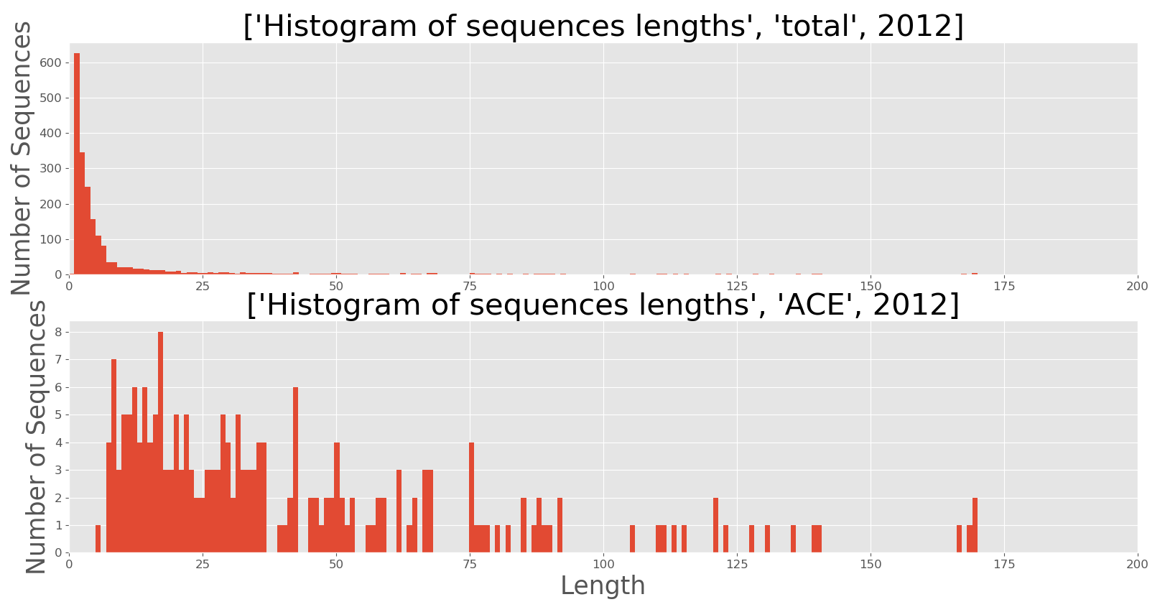
Figure 6: Histograms of sequence lengths before and after processing

Slide 10
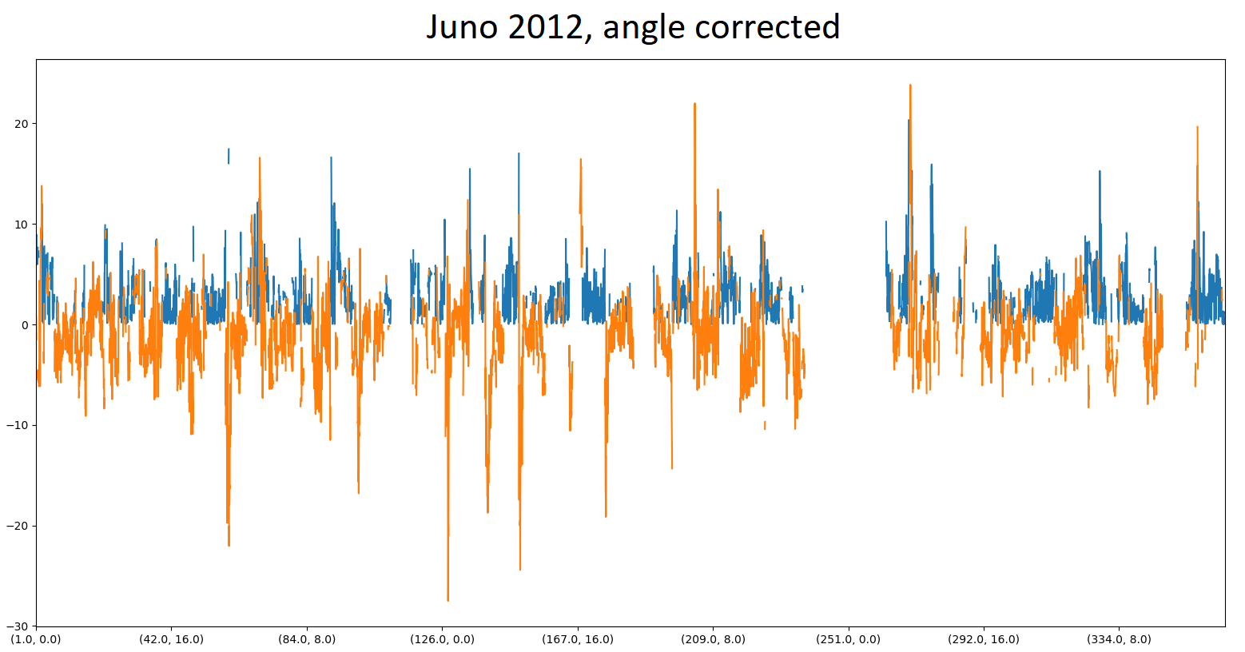

Figure 7: IMF Split via sector

Slide 11
Comparing negative and positive sectors
Averaging periods different for ACE and Juno.
Averaged over 2 cycles to remove the effect of CIR’s for 2012
Averages Field Strength R²Br (AU^2 nT)
Juno |  | Ace
Positive | Negative | Positive | Negative
3.5±1.9 | -3.2±1.4 | 2.5±1.1 | -2.6±2.1
Table 1: The average values for Juno and ACE, across 2012

Slide 12
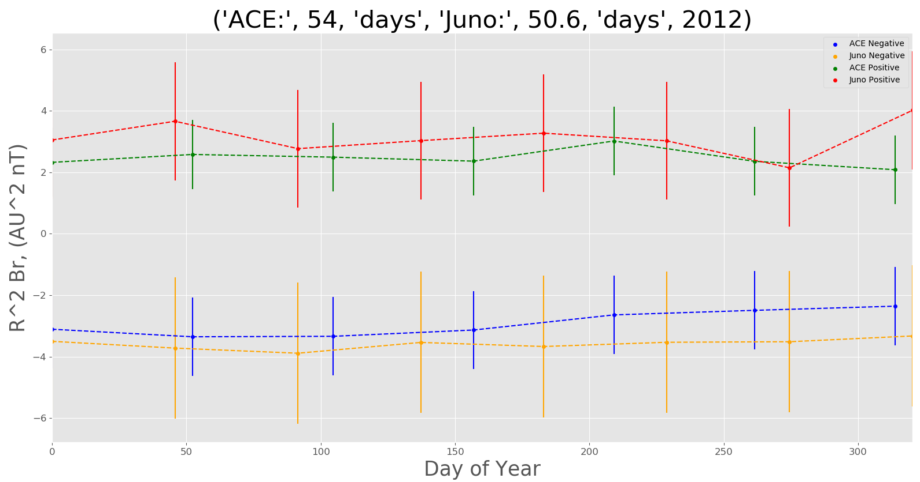
Figure 8: 2 Solar rotation averages

Slide 13
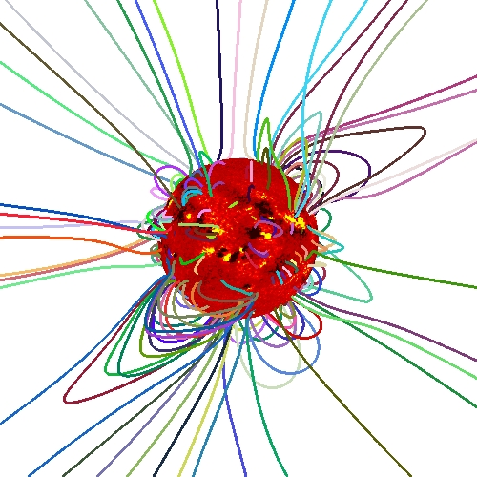
Comments on result
The HCS gets distorted by solar wind.
Juno and ACE not often at similar magnetic regions, sunspot lifetimes limit comparison
Figure 9: The structure of current loops on the sun for 2001.
Picture from:
http://predsci.com/corona/jun01eclipse/jun01eclipse.htm

Slide 14
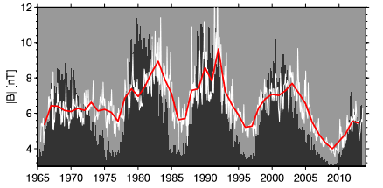
Relation to Sunspot Activity
Magnetic loops poke through the Sun’s surface at sunspots
IMF strength follows sunspot number
Significant decrease over 2 cycles
Figure 10: Comparison of yearly changes in sunspot number and magnetic field. Black lines are sunspot number, red line is magnetic field strength.
Picture from:
https://link.springer.com/article/10.12942/lrsp-2013-5

Slide 15
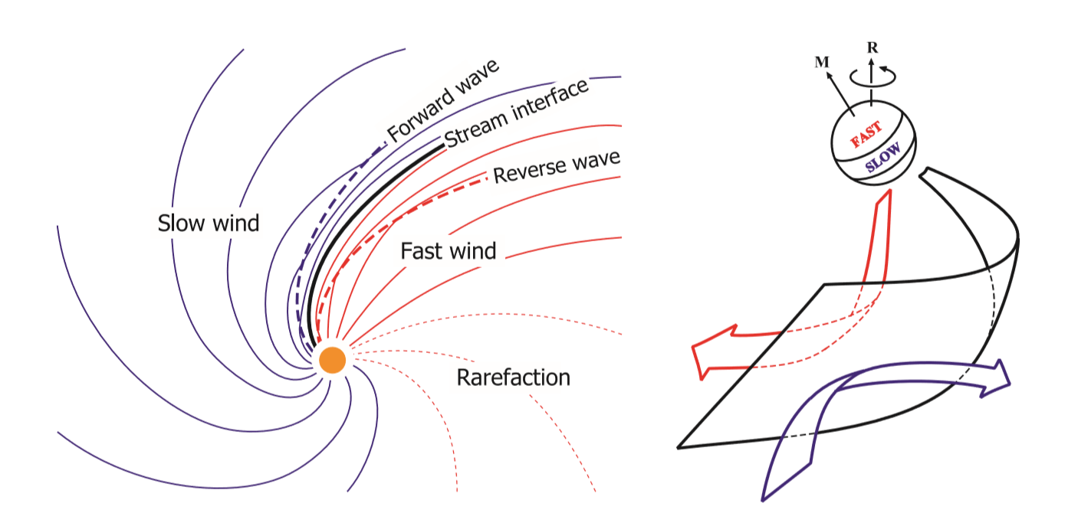
Observation of 2015 and 2016 data
Data from 2015 and 2016 was analysed
R²Br = 6.5 AU²nT , Juno
R²Br = 3.4 AU²nT , ACE.
Possible cause: Corotating Interaction regions, CIRs.
Figure 11: CIR result from compression between fast and slow Solar wind
Picture from:
https://link.springer.com/article/10.12942/lrsp-2013-5

Slide 16
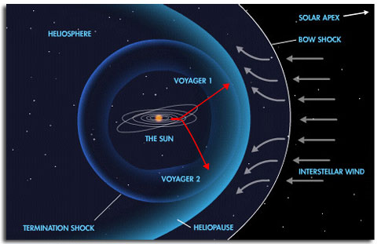
Conclusion
Analysed the HCS and the dipole nature of the Sun
Matching of R²Br for Juno and ACE for 2 solar Rotations
Explored a 2 cycle decrease in Field Strength.
Figure 12: Interstellar medium deflected by magnetic field
Picture from: https://ryanoursun.wikispaces.com/The+Journey+Of+Solar+Wind+In+The+Solar+System+And+Earth_Ethan

Slide 17
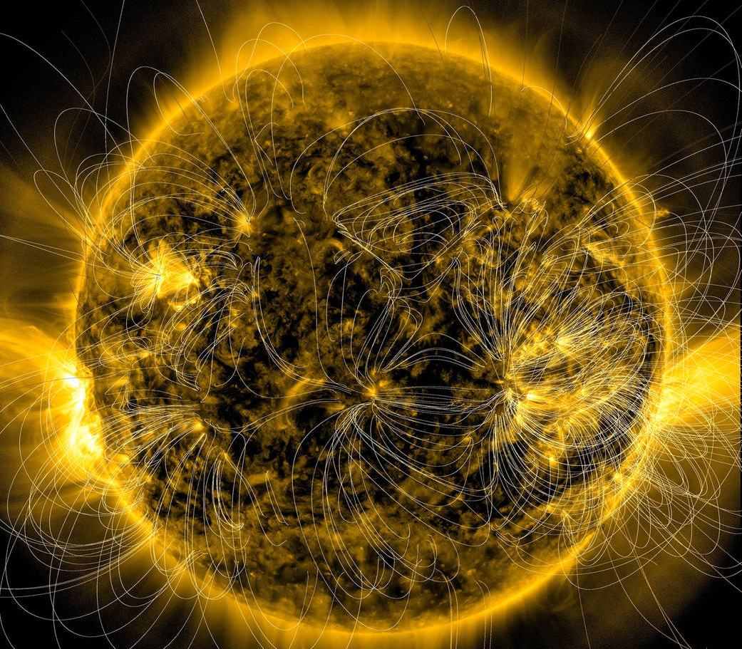
Questions
Picture from: https://sdo.gsfc.nasa.gov/gallery/potw/item/593

